Slide 1
Team 5 – Rotor Blade Structures
Week No - 5
Date - 28.10.2025
Supervisor - Dr. Laurence Alhrshy
Presented by – Bhima Babu Masare (770246)
Team Members - Bhima B Masare, Anudeep Allanki, Dongsuk Kim, Mithun Shetty

Slide 2
Contents
Rotor Blade Structures Team Time line
Tasks planned for Project
Spar Cap Thickness and Deflection Analysis
3.1 Aim
3.2 Model Inputs and Material Parameters
3.3 Thickness and Deflection Calculations
3.4 Plots from MatLab
3.5 Test-3 vs Test-2 Code Results
3.6 Design Implications
3.7 Results and Design Insights
3.8 Conclusions
Bibliography
Bhima Babu Masare

Slide 3
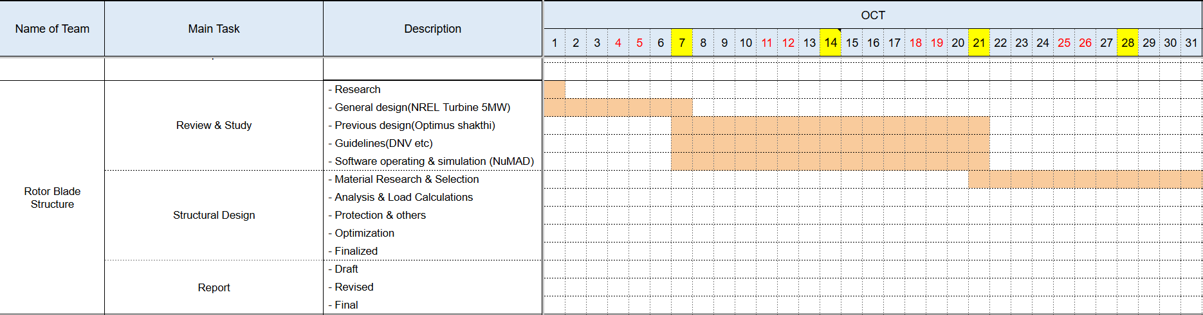
1. Rotor Blade Structures Team Time line -
1.1 Team Time line for Month October -
Bhima Babu Masare

Slide 4
2. Tasks planned for Project –
Material Selection
Spar Cap & Shear Web Thickness
Develop Blade Model in NuMAD
Analysis with Precomp
Iterate and refine the design
Mithun Shetty

Slide 5
3. Spar Cap Thickness and Deflection Analysis –
3.1 Spar Cap Thickness and Deflection Analysis –
Aim - Determine spar cap thickness for carbon and glass fiber considering strength and deflection limits
Based on blade spanwise load and geometry data from loads.csv and thickness.csv
Compare strength-based and stiffness-based designs
Evaluate maximum deflection against allowable limit
Task given by Prof. Previtali & Prof. Alhrshy
Bhima Babu Masare

Slide 6
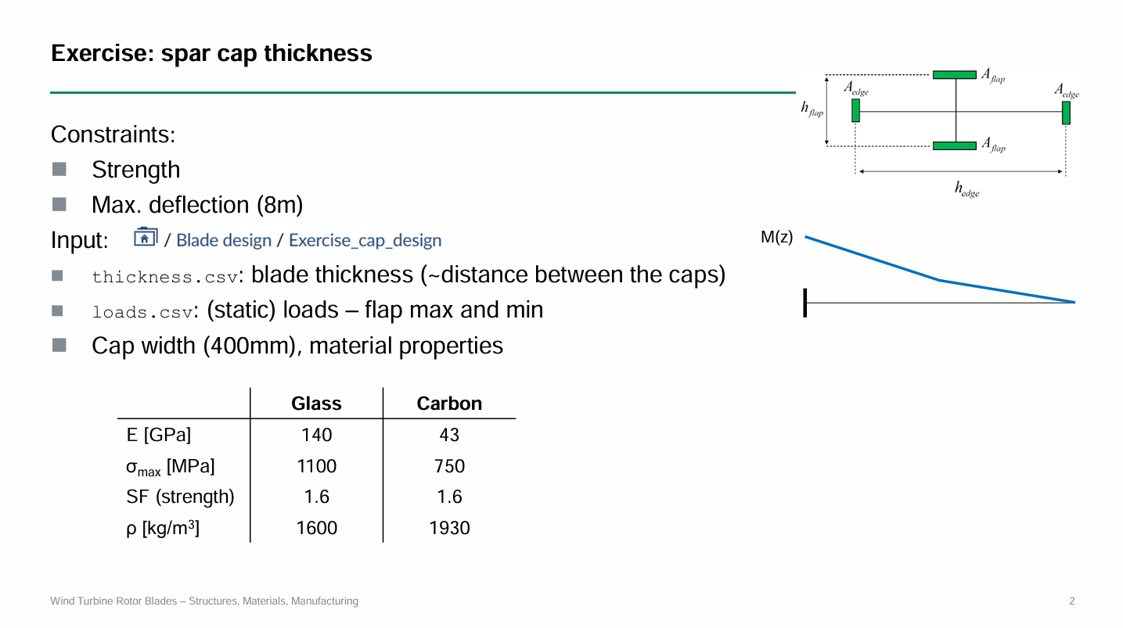
3. Spar Cap Thickness and Deflection Analysis –
3.1 Spar Cap Thickness and Deflection Analysis –
Task given by Prof. Previtali & Prof. Alhrshy
Correction –
Carbon - E = 140 GPa,
Glass E = 43 GPa
Bhima Babu Masare

Slide 7
3. Spar Cap Thickness and Deflection Analysis –
3.2 Model Inputs and Material Parameters –
Input Tables –
loads.csv: spanwise position & flapwise bending moments
thickness.csv: blade thickness (distance between spar caps)
Material Properties –
Carbon Fiber: E = 140 GPa, σ_max = 1100 MPa, ρ = 1600 kg/m³, SF = 1.6
Glass Fiber: E = 43 GPa, σ_max = 750 MPa, ρ = 1930 kg/m³, SF = 1.6
Bhima Babu Masare

Slide 8
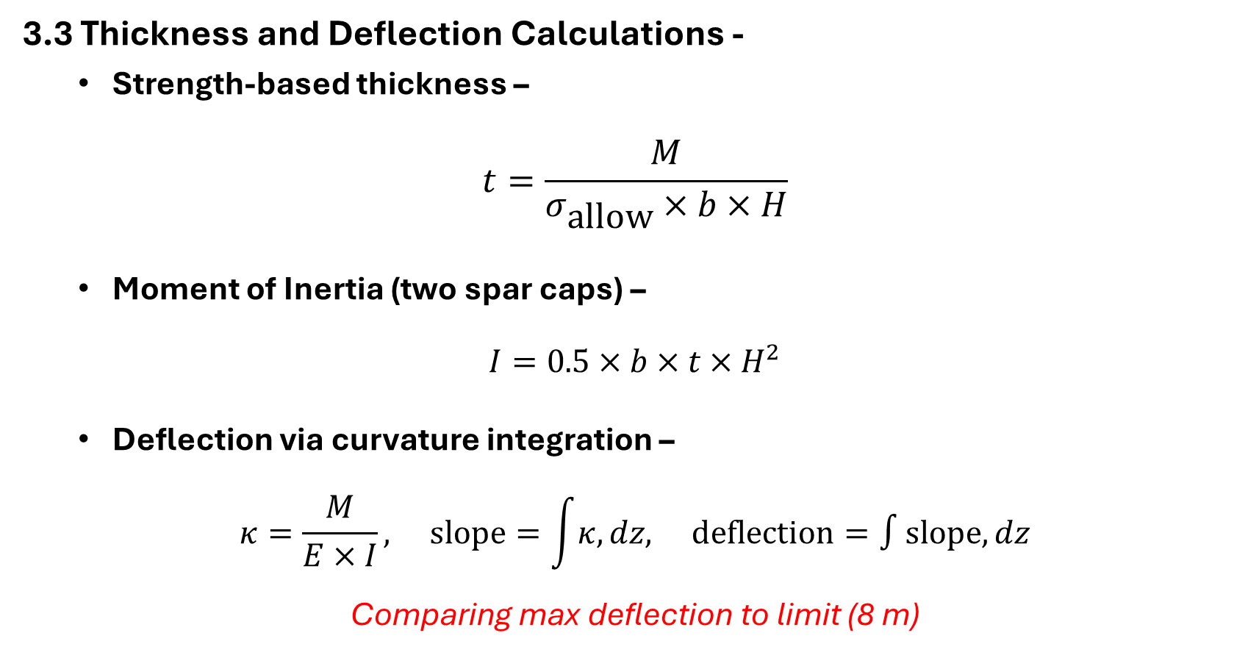
3. Spar Cap Thickness and Deflection Analysis –
3.3 Thickness and Deflection Calculations -
Strength-based thickness –
$$t=\frac{M}{σ_{\text{allow}}×b×H}$$
Moment of Inertia (two spar caps) –
$$I=0.5×b×t×H^{2}$$
Deflection via curvature integration –
$$κ=\frac{M}{E×I}, \text{slope}=\int{κ,}dz, \text{deflection}=∫\text{slope},dz$$
Comparing max deflection to limit (8 m)
Bhima Babu Masare

Slide 9
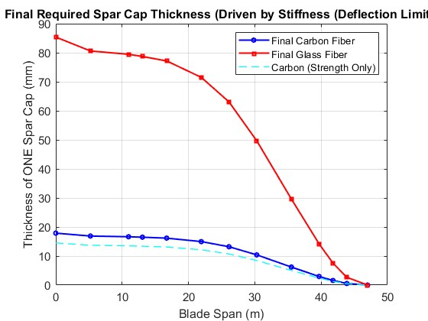
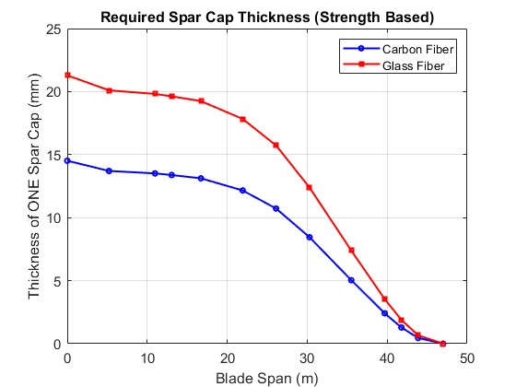
3. Spar Cap Thickness and Deflection Analysis –
3.4 Plots from MatLab –
Test 2
Test 3
Bhima Babu Masare

Slide 10
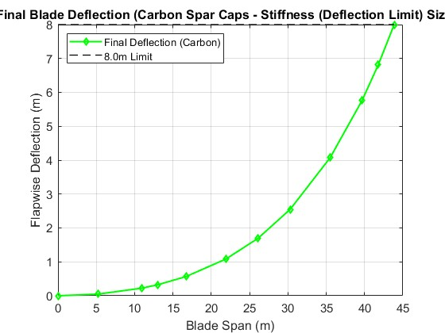
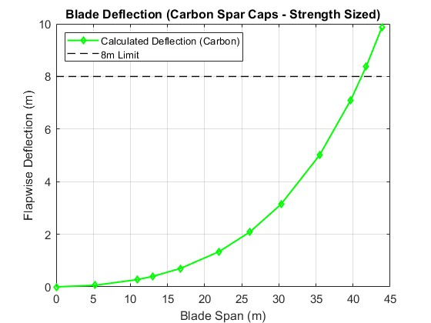
3. Spar Cap Thickness and Deflection Analysis –
3.4 Plots from MatLab –
Test 2
Test 3
Bhima Babu Masare

Slide 11
3. Spar Cap Thickness and Deflection Analysis –
3.5 Test-3 vs Test-2 Code Results –
Test-3: Based on Minimum thickness (no deflection limit) – deflection reached ≈ 9.85 m (beyond 8 m limit)
Test-2: Includes deflection limit (8 m) – increases spar cap thickness to stay within limit
Summary –
Both start with strength-based sizing
Updated code adds stiffness check and increases thickness when deflection > 8 m
Ensures blade remains structurally safe and stiff
Bhima Babu Masare

Slide 12
3. Spar Cap Thickness and Deflection Analysis –
3.6 Design Implications –
Adding stiffness control ensures deflection stays within safe limit
Thicker spar caps → stiffer & safer blade, but with added weight
Final design governed by stiffness, not just strength
Provides balanced structural and aerodynamic performance
Overall: Improved safety, lower stress, and better blade reliability
Bhima Babu Masare

Slide 13
3. Spar Cap Thickness and Deflection Analysis –
3.7 Results and Design Insights –
Carbon –
Final deflection ≤ 8 m
Design driver: Strength / Stiffness (case-dependent)
Glass –
Requires greater thickness due to lower stiffness
Final plots:
Thickness distribution (Carbon vs Glass)
Blade deflection curve
Bhima Babu Masare

Slide 14
3. Spar Cap Thickness and Deflection Analysis –
3.8 Conclusions –
Deflection limit can govern spar cap design
MATLAB approach enables flexible spanwise optimization
We can alter all above calculations for our Project and get the final output
Bhima Babu Masare

Slide 15
Bibliography
Definition of a 5 MW/61.5m Wind Turbine Blade Reference Model by Brian R. Resor, Sandia National Laboratories, California, USA
Definition of a 5 MW Reference Wind Turbine for Offshore System Development, J. Jonkman, S. Butterfield, W. Musial, and G. Scott, National Renewable Energy Laboratory, USA
Reports from Optimus Shakthi 2024
Lecture Scripts from Prof. Dr. Francesco Previtali
Lecture Scripts from Prof. Dr. Laurence Alhrshy
Bhima Babu Masare

